Slide 1


Feature Extraction and Price Prediction for Mobile Phones Project -4
ASHA SANDEEP
NOIDA
DIGICHROME ACADEMY

Slide 2
Introduction
Project Description:- In this project, I worked with a dataset that contains detailed information about various mobile phones, including their model, color, memory, RAM, battery capacity, rear camera specifications, front camera specifications, presence of AI lens, mobile height, processor, and most importantly, the Price. My primary goal is to develop a predictive model for mobile phone prices.

Slide 3
Project Overview
Project Overview
This project aims to predict the prices of mobile phones based on their specifications using machine learning models. By understanding the key factors that influence mobile phone prices, we can provide valuable insights for consumers, manufacturers, and retailers.

Slide 4
Problem Statement
Problem Statement:
The goal is to predict the prices of mobile phones based on various features such as model, colour, and other specifications. Accurate predictions will help in pricing strategies and market analysis.

Slide 5
Solution
I got the solution from the google,geeks for geeks and chat Gtp and delete some code used before .

Slide 6
Methodology
Data Exploration-
Data Preprocessing
Feature Extraction
Feature Engineering
Model Building
Model Evaluation
Feature Importance Analysis
Report and Visualization
Recommendations

Slide 7
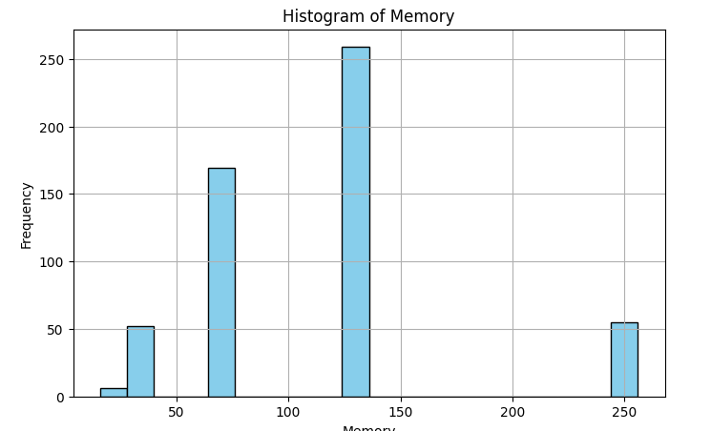
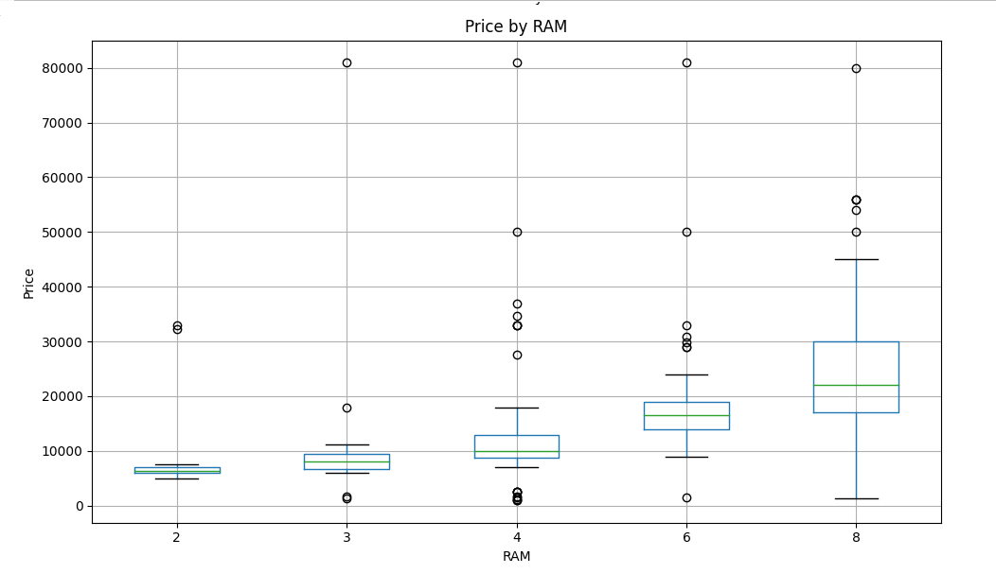
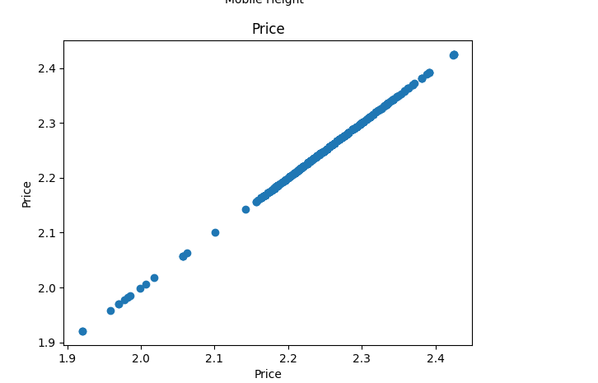
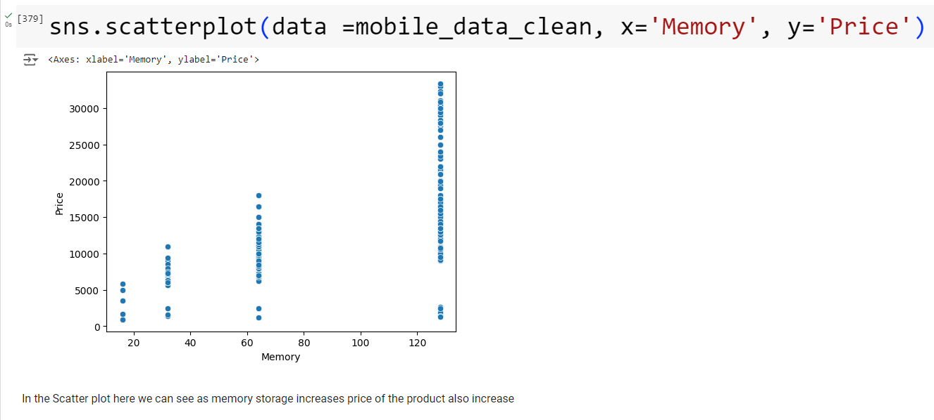
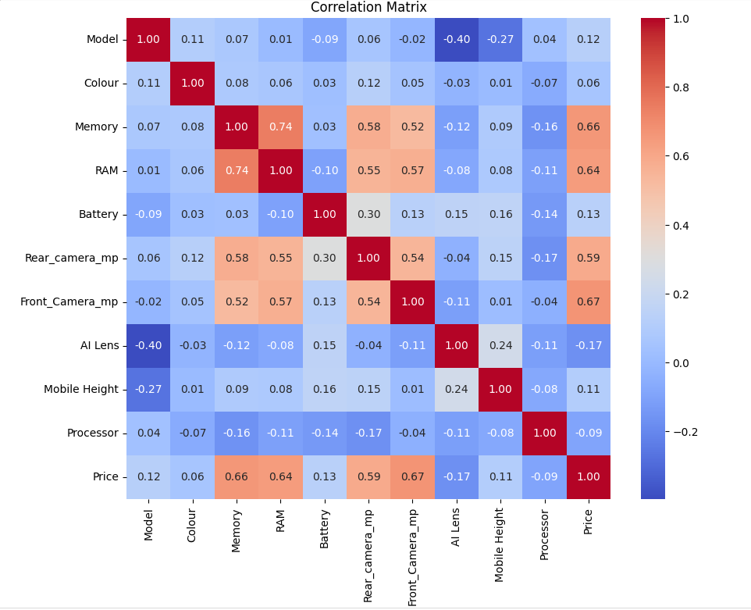
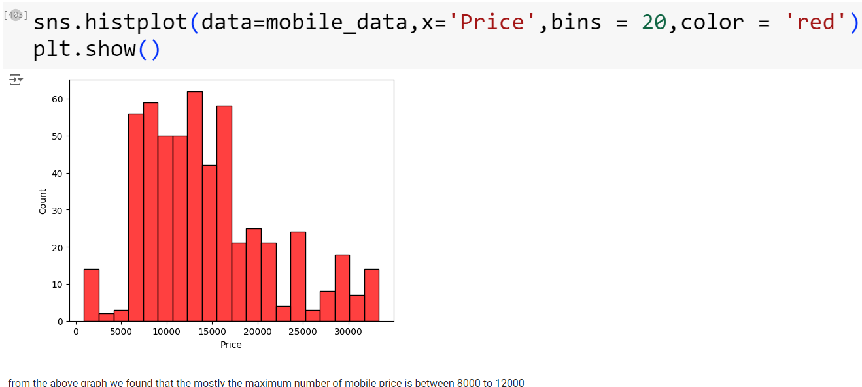
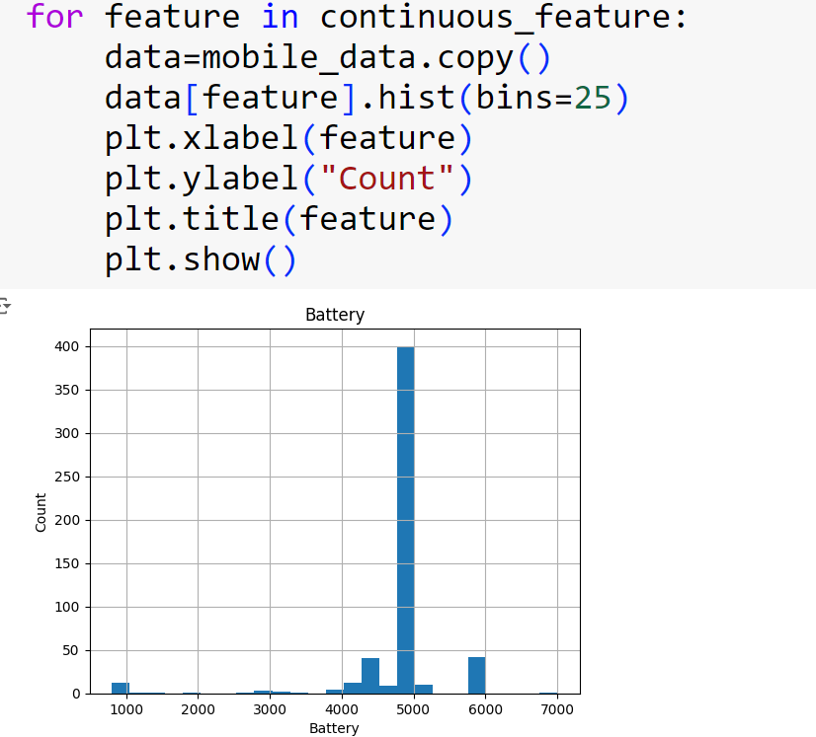
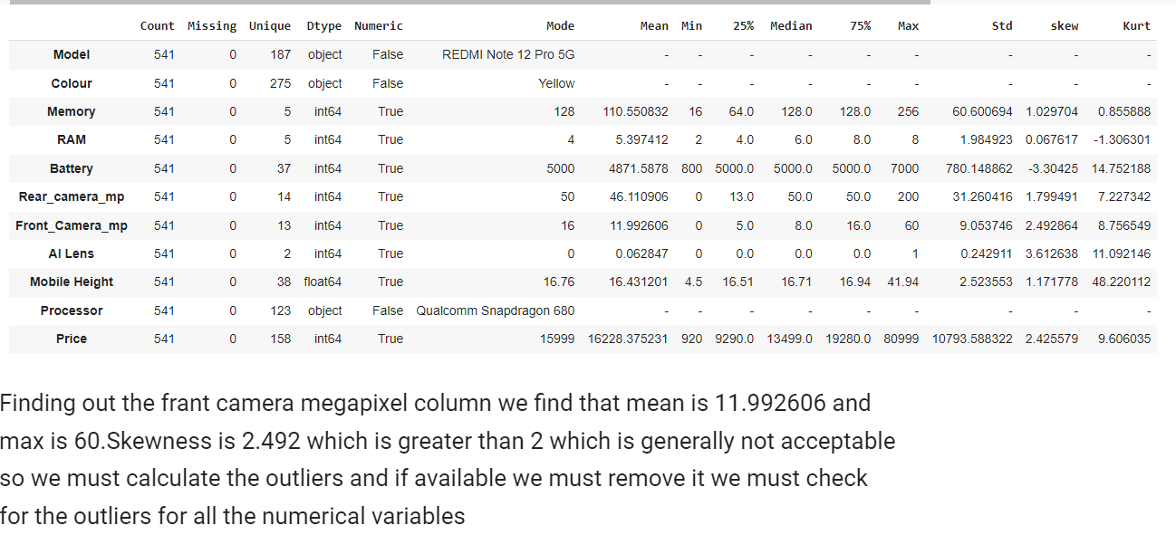
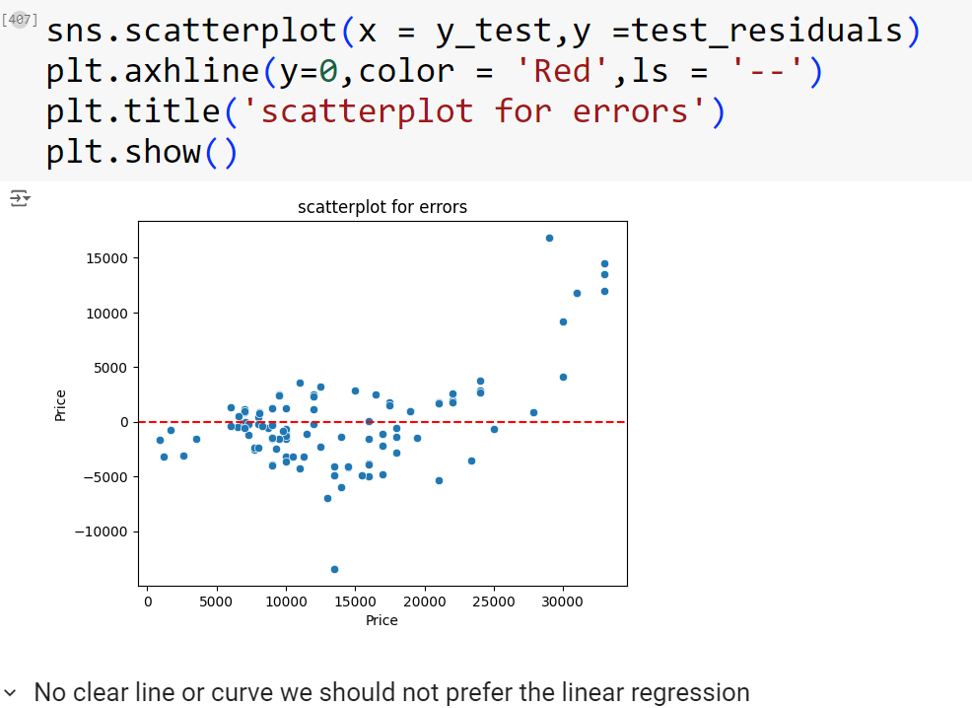
Key features

Slide 8
Result & Achievements
Result
Improved Data Quality:
Effective Feature Engineering
Model Development and Evaluation:
Feature Importance Analysis:
Time-Series Analysis:
Achievements
Enhanced Predictive Accuracy:
Through effective feature engineering and model tuning, achieved a predictive accuracy (R2 score) within the expected range of 75%-85%, with some models exceeding 85%
Comprehensive Reporting:
Documented the entire process, including data exploration, preprocessing, feature engineering, model development, and evaluation, ensuring transparency and reproducibility of the results.
Created detailed visualizations and reports that effectively communicate the findings and insights to non-technical stakeholder
Knowledge and Skill Enhancement:
Gained valuable experience and expertise in handling real-world datasets, applying advanced machine learning techniques, and addressing common data science challenges.
Enhanced skills in Python, Pandas, Matplotlib, Seaborn, and various machine learning libraries, contributing to personal and professional growth

Slide 9
Challenges faced
When i was doing this project i Faced the challenges like
1-Error occur and findings their accurate solution .
2.NAN value come while fitting the model .
3.when i used the pd.get dummy code .so many error came in my project file so i removed it as my mentor suggest me.

Slide 10
Conclusion
Conclusion
This project demonstrates the process of building a predictive model for mobile phone prices, from data exploration and preprocessing to feature extraction and model evaluation. The insights gained can help inform better decision-making in the mobile phone market.

Slide 11
Thank you

